Slide 1
Start Fundraising Now: Your Formula for Year-End Asks
Best Friends Network Webinar
October 22, 2024
BFNetwork@bestfriends.org
Notes:
Katelyn

Slide 2
Today's Speakers
Panelists:
Whitney Zoghby, Executive Director, Paws4ever (she/her/hers)
Michelle Dosson, Pacific Regional Director, Best Friends Animal Society (she/they/theirs)
Sarah Goldberg, Philanthropy Advisor, Best Friends Animal Society (she/her/hers)
Moderator
Katelyn Durkin, Manager, Network Partner Relations, Best Friends Animal Society (she/her/hers), bfnetwork@bestfriends.org
Notes:
Katelyn

Slide 3
Basics of Donor Cultivation
Raising more money will help you save more animals. ​
Donors want you to save more animals, so they'll
help you raise more money!
Send out a Newsletter - 4x a year
Call your supporters – 1 time in a year AND after they donate is the best time to engage
Create a yearend appeal and ask for money! – You can do this a few times a year – yearend at minimum
Notes:
Sarah

Slide 4
Key Dates
October: Prep
Clean up data
Draft letters (snail mail & email)
What story will you tell? What do you have photos of?
Draft social media campaign
Schedule printing
Plan for volunteers to stuff envelopes and handwrite (ideal) envelopes or apply printed labels
Notes:
Sarah

Slide 5
Key Dates
November
Print – Stuff – Address on repeat
Send the letter in the mail by November 15 (ideal) and November 22 (at the latest)
Getting it in the mail BEFORE Thanksgiving improves results
Draft Giving Tuesday email and social media posts
December
Thank-you calls as gifts come in
12/3: Giving Tuesday
Send Giving Tuesday email
Post Giving Tuesday posts
12/27ish: Send email w/final reminder to donate before year-end
Make it more engaging with a link to a video and social media post
Plan "Year in Review" highlight social posts w/donate link to your website (not FB)
Notes:
Sarah

Slide 6
The Formula
Make it personal
Recognize the donor's impact
Share ONE powerful story of impact with photo(s)
Make a clear Call To Action
Create a sense of urgency*
Share what the donor has helped you accomplish
Share the impact they can make with their gift
*Keep it positive, actionable, uplifting. Data is great to share here!
Notes:
Sarah

Slide 7
The Formula: A Sample Letter
THE BEGINNING
2. Recognize donor's impact
3. Create urgency
Dear [Donor Name],
The team and I at XYZ Animal Shelter have worked tirelessly this year to save as many pets as possible and we could not have done it without people like you who support our lifesaving efforts. As the year began, we knew that we had an uphill road in front of us – but we were more motivated than ever to help homeless pets in our community.
I am proud to say that we cared for over XXX pets so far in 2024! That is up from XXX animals at this time in 2023. None of this would be possible without people like you who support us. Your generosity has not only saved lives, but you made my team and I feel supported as we work through the day-to-day challenges.
1. Make it personal
4. Share what they've helped you accomplish
Notes:
Sarah
"You'll be getting copies of this template"

Slide 8
The Formula: A Sample Letter
4. Share what they've helped you accomplish
THE MIDDLE
Through adoptions, transports, spay/neutering, vaccine clinics, fosters and volunteering and so much more – our team is working to maximize your donations so that we can continue to help pets that need us. Here are just a few examples of what you helped us accomplish this past year:
You helped us save INSERT DOG STORY from the year. Tell a short story about a pet that came into your care and you supported in many ways. Medical or behavior and is now in a happy adoptive home that you can share a brief update and a few pics of.
PICS PICS PICS PICS PICS PICS
You supported our vaccine and spay neuter clinic. In 2024, so many pet parents throughout our community needed help to provide care for their pets and thanks to you, we provided care to XXX pets in our community. Highlight the program you are most proud of.
5. Share ONE powerful story of impact with photos
6. Share the impact they can make with their gift
Notes:
Sarah
"You'll be getting copies of this template"

Slide 9
The Formula: A Sample Letter
THE END
As we reflect on 2024, we are proud of what we accomplished and all the lives that we saved but the need continues to grow. We want to be there to help the pets and people that need us in 2025 – will you join us?
[Donor Name], will you consider making a special gift for the animals? Please use the enclosed envelope or visit www.OurDonationLink.com to help us care for even more animals in 2025.
We wish you all the best this holiday season,
Personal signature*
Staff Name
Staff Title
Organization Name
*If you can dedicate any staff/board/volunteer time to personally sign letters of high-level donors, this could help increase your donations.
7. Make a clear Call To Action
Notes:
Sarah
"You'll be getting copies of this template"

Slide 10
Examples
Notes:
Katelyn-introducing next section

Slide 11
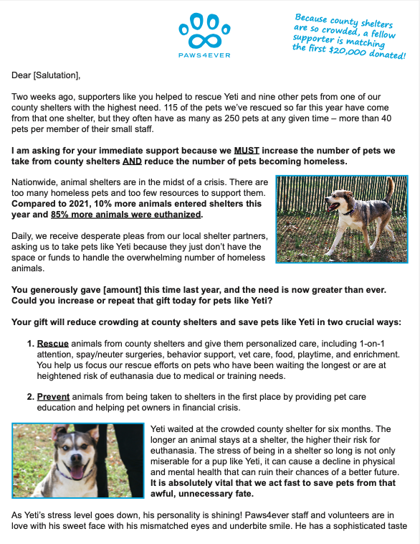
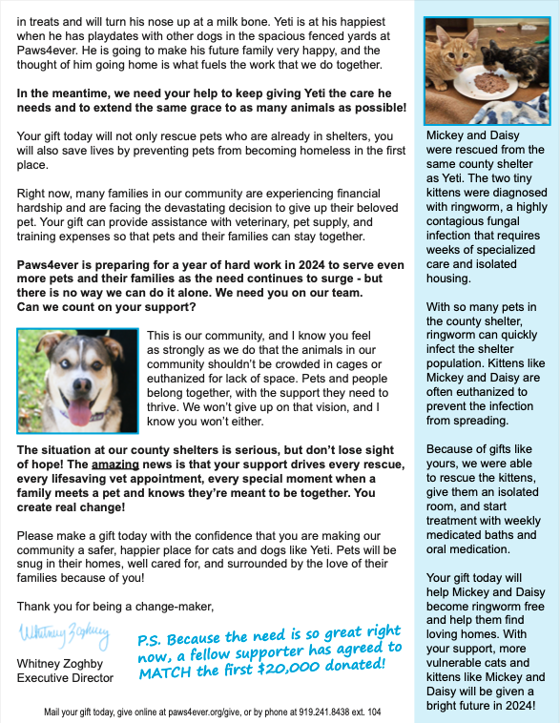
Direct Mail Example
Paws4ever​
Notes:
Whitney (Sarah can interject to point out best practices, other notable things)

Slide 12
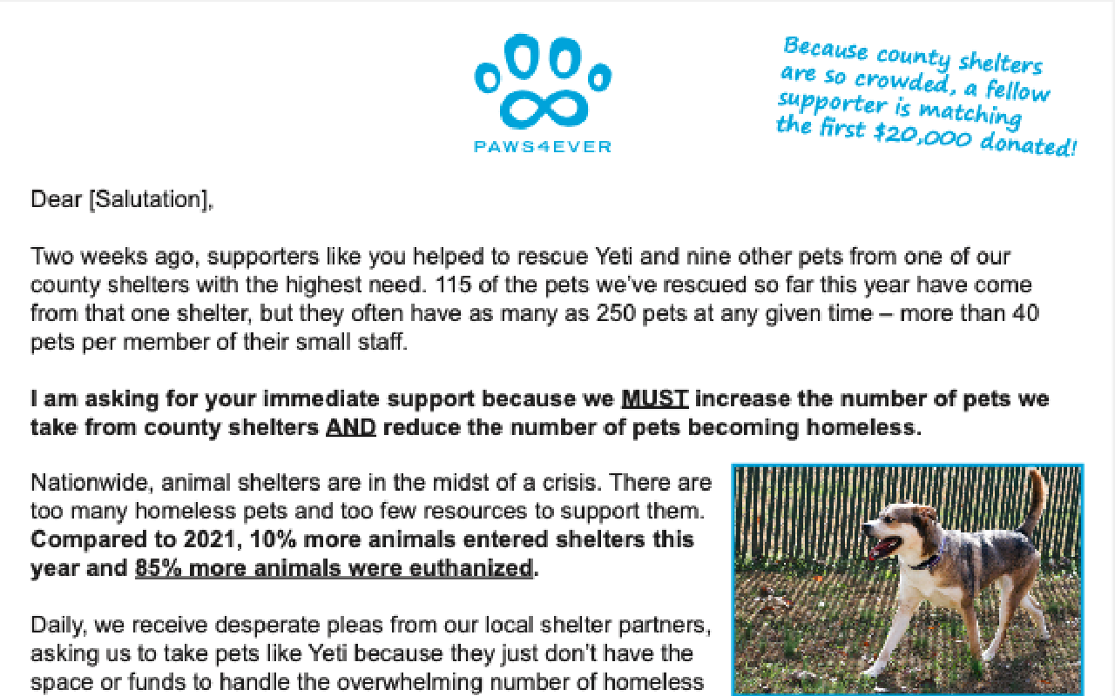
Notes:
Whitney (Sarah can interject to point out best practices, other notable things)

Slide 13
Paws4ever: Direct Mail Results
Raised $67,553
Mailed to 2,725 existing donors
Cost: Roughly $3,000 for professional printing and mailing
Additional costs:
Donor database to track donor information
Staff time developing/writing the letter
Staff time hand-writing personal notes on highest-level donors
Notes:
Whitney (Sarah can interject to point out best practices, other notable things)
Highlight that Paws4ever works hard to steward their donors all year
"You'll receive resources on how to start stewarding donors next year"

Slide 14
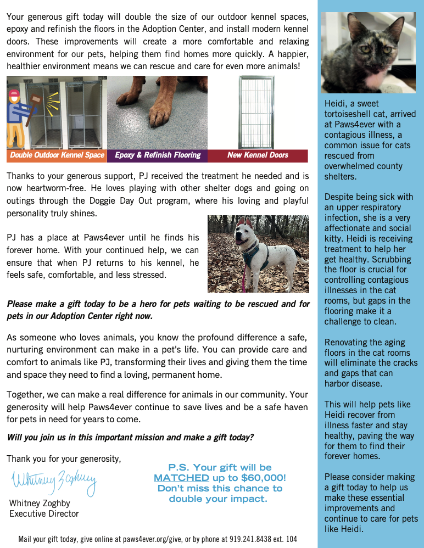
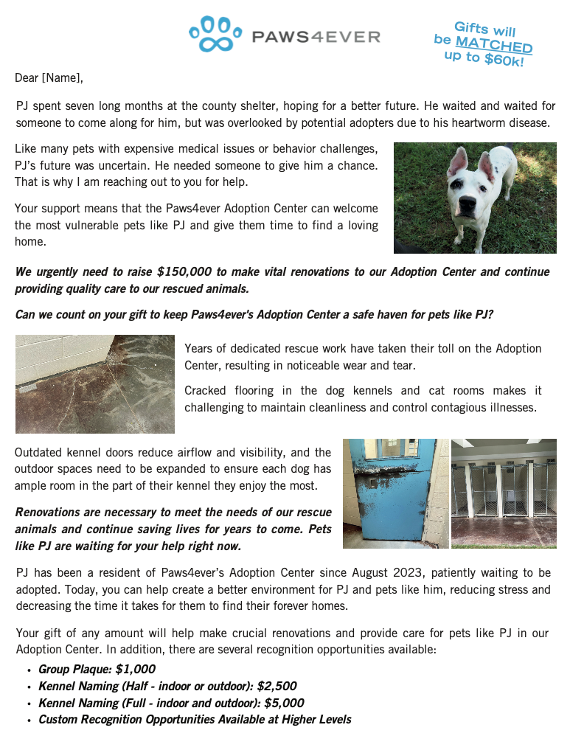
Direct Mail Example
Paws4ever​
Notes:
Whitney (Sarah can interject to point out best practices, other notable things)
Whitney: briefly explain how to even source a printer at some point

Slide 15
Notes:
Whitney (Sarah can interject to point out best practices, other notable things)

Slide 16
Paws4ever: Direct Mail Results
Raised $52,544
Mailed to 2,698 existing donors
Cost: Roughly $3,000 for professional printing and mailing
Additional costs:
Donor database to track donor information
Staff time developing/writing the letter
Staff time hand-writing personal notes on highest-level donors
Notes:
Whitney

Slide 17
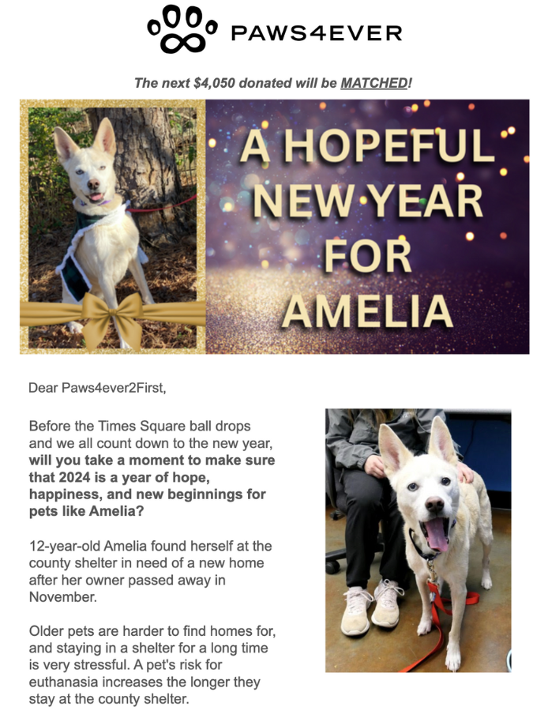
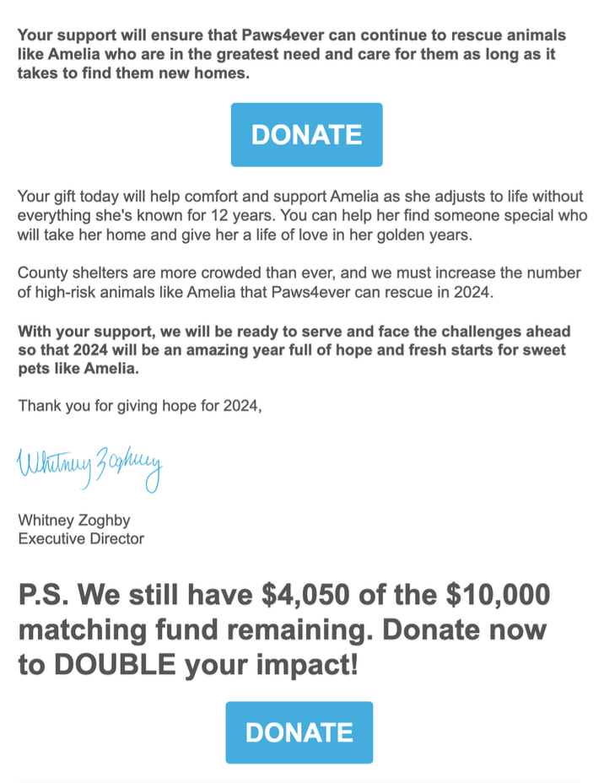
Email Example
Paws4ever​
Subject:
A New Year for Amelia - Gifts MATCHED!
Notes:
Whitney (Sarah can interject to point out best practices, other notable things)

Slide 18
Paws4ever: Email Results
Raised $3,017
Sent to 6,353 emails
Cost: Monthly/annual fee for email system
Additional costs:
Donor database to track donor information
Staff time developing/writing the letter
Notes:
Whitney

Slide 19
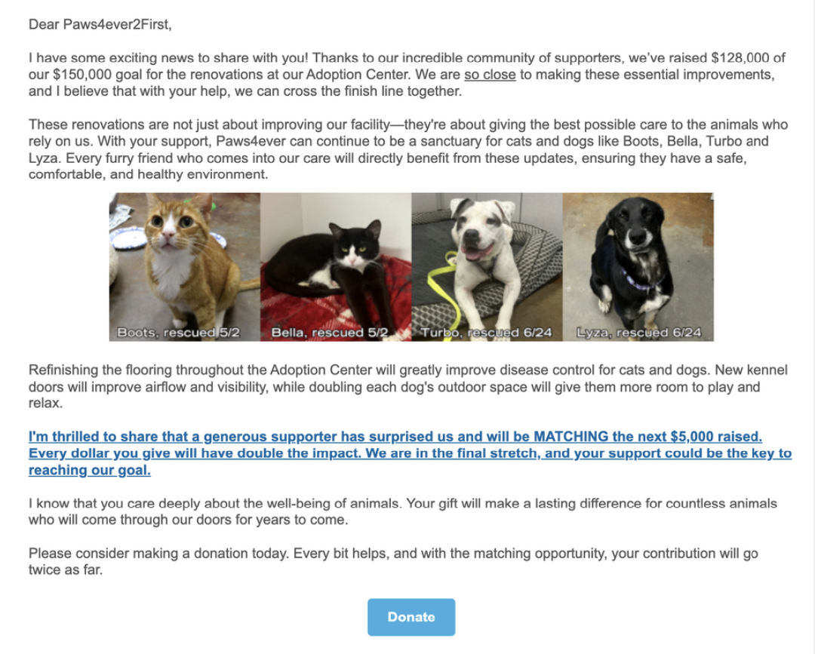
Email Example
Paws4ever​
Subject: Urgent request to help our animals
Notes:
Whitney (Sarah can interject to point out best practices, other notable things)

Slide 20
Paws4ever: Email Results
Raised $12,662
Sent to 6,237 emails
Cost: Monthly/annual fee for email system
Additional costs:
Donor database to track donor information
Staff time developing/writing the letter
Notes:
Whitney

Slide 21
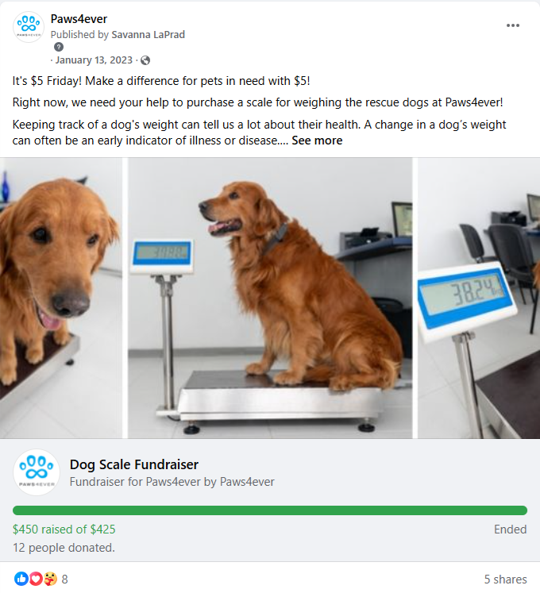
Social Media Example
Paws4ever​
RESULTS
$450 raised of $425 goal
8.1k (current) followers
Cost: $0
Notes:
Whitney
Whitney and Sarah transparently discuss the pros and cons of social media fundraising

Slide 22
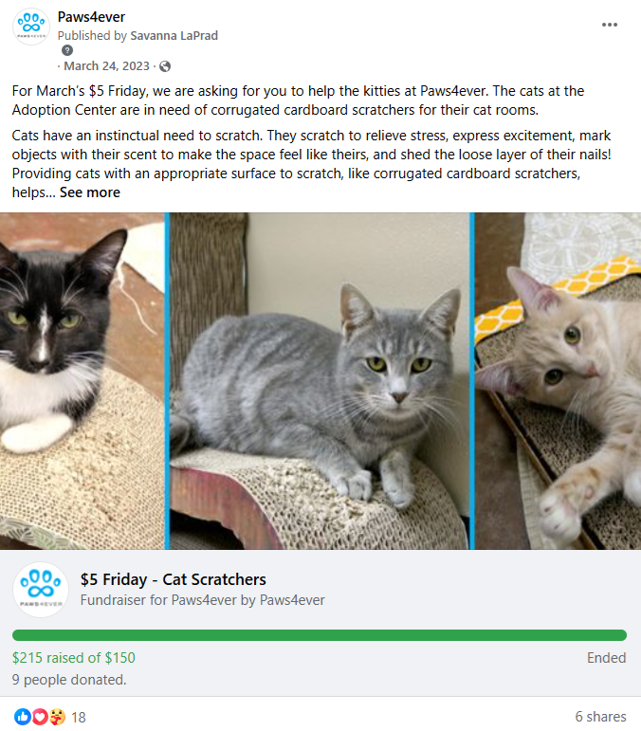
Social Media Example
Paws4ever​
RESULTS
$215 raised of $150 goal
8.1k (current) followers
Cost: $0
Notes:
Whitney
Whitney and Sarah transparently discuss the pros and cons of social media fundraising

Slide 23
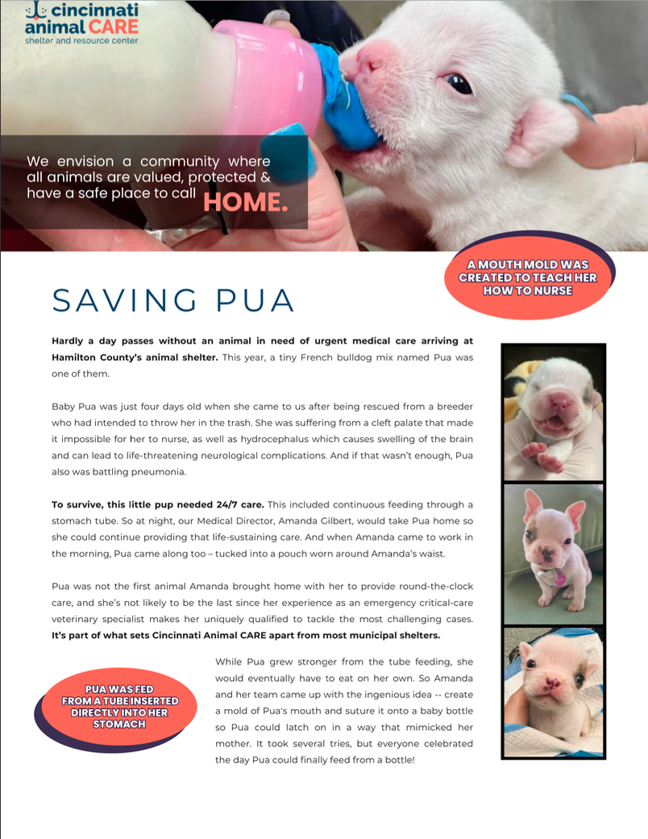
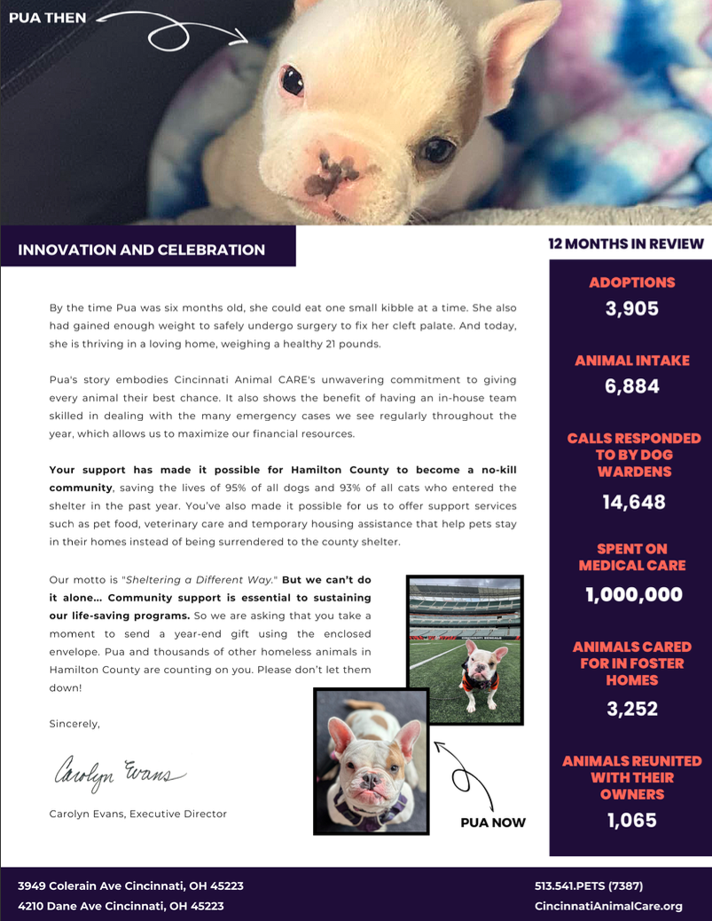
Direct Mail Example
Cincinnati Animal CARE
Notes:
Dosson
Since we don't have concrete results numbers, can you talk generally about the results?

Slide 24
Notes:
Dosson
Since we don't have concrete results numbers, can you talk generally about the results?

Slide 25
Municipal considerations
Is working with a cooperative 501c3 or "Friends of" an option? This may be the path with the least red tape and headaches.
IRS 170(c)(1): provision for fundraising by government agencies: gives qualifications & responsibilities. You can request a governmental information letter for proof of this IRS status.
Are you starting from scratch with fundraising for your municipal shelter? Ask these questions first:
Is your department allowed to independently accept individual donations, or does city council have to approve them?
Is there a donations fund where you can ensure donated funds will be protected and separated?
Notes:
Dosson
Network has Municipal Fundraising Playbook that will most likely be in the chat while you're speaking

Slide 26
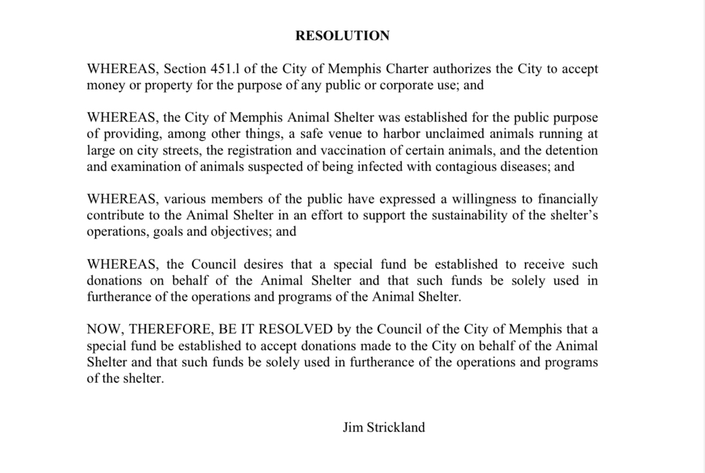
Municipal considerations
Best Friends Animal Society cannot provide legal advice.
Notes:
Dosson
"You'll get template of this ordinance you can share with your city attorney"

Slide 27
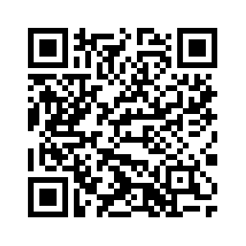
Resources
Resources to support you with:
Data
Direct mail
Email
Social media fundraising
Donor stewardship & cultivation
Government fundraising
And more!
Scan here
Bookmark the page
Check back in a few days for the webinar replay & resources!
Notes:
Katelyn

